Slide 1

FridgeMate

Slide 2
What:
An app to match your kitchen
ingredients to recipes!
Notes:
“What are we building?”

Slide 3
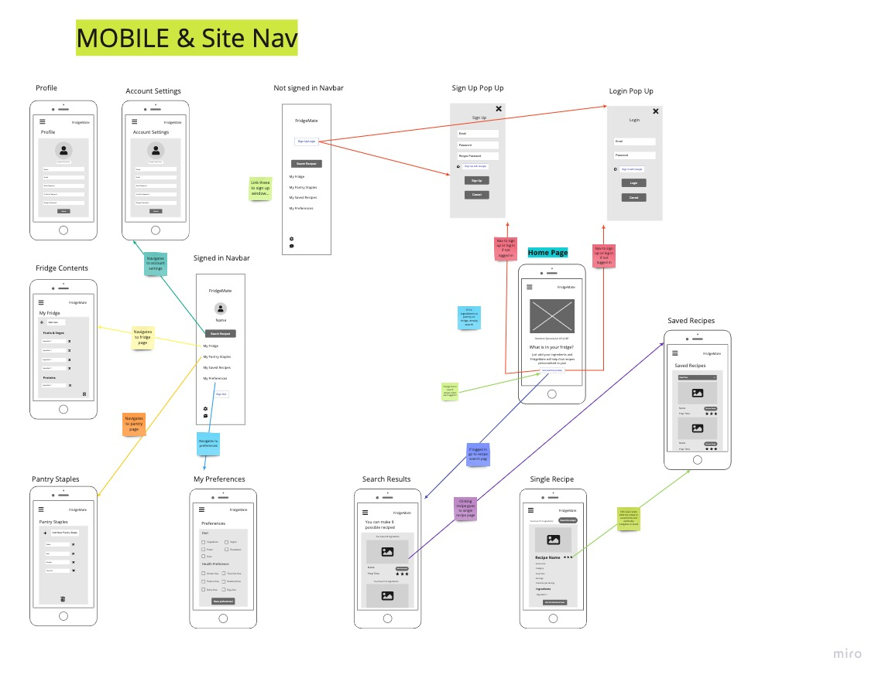
What:
Notes:
Skim over – point is we have all the wireframes with navigation

Slide 4
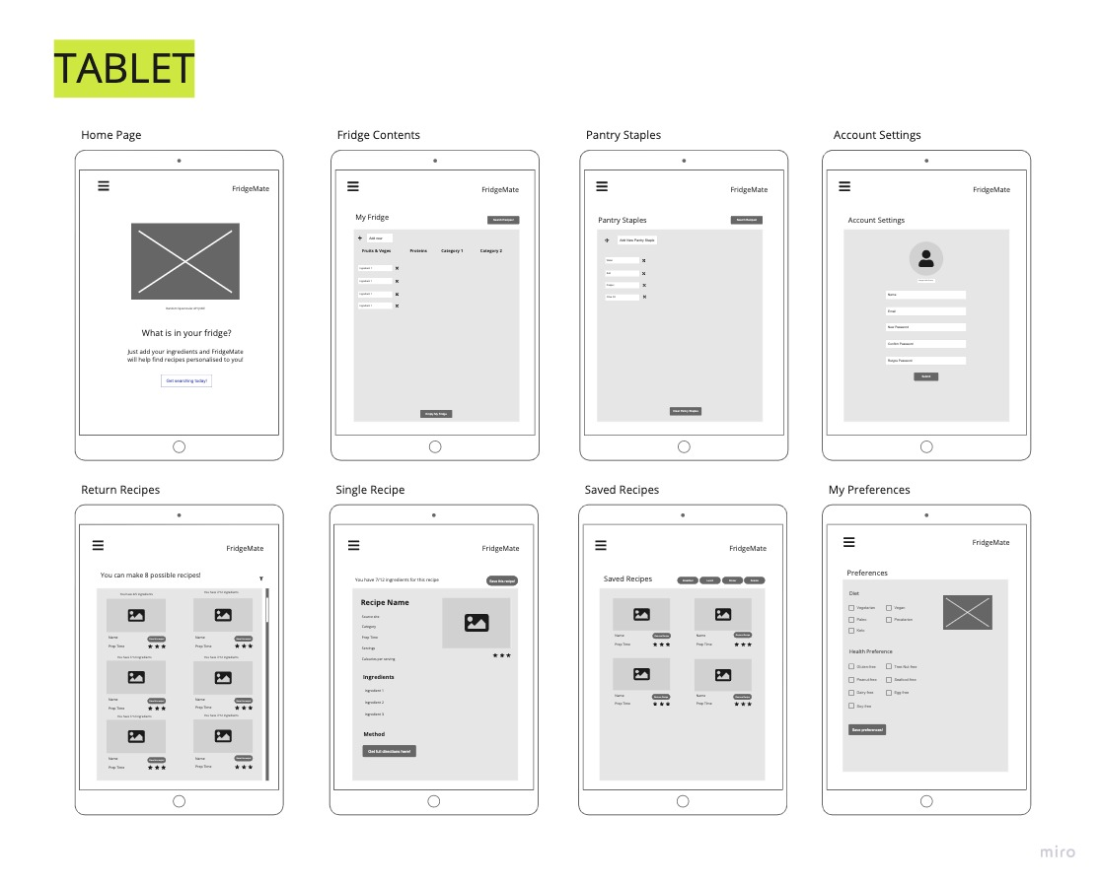
What:
Notes:
Skim over – we have all the wireframes

Slide 5
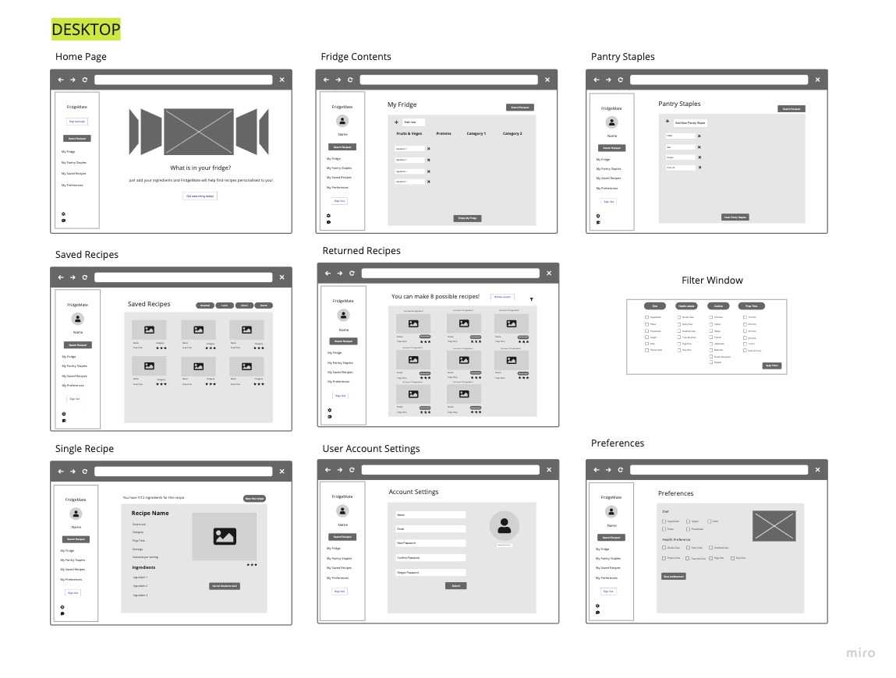
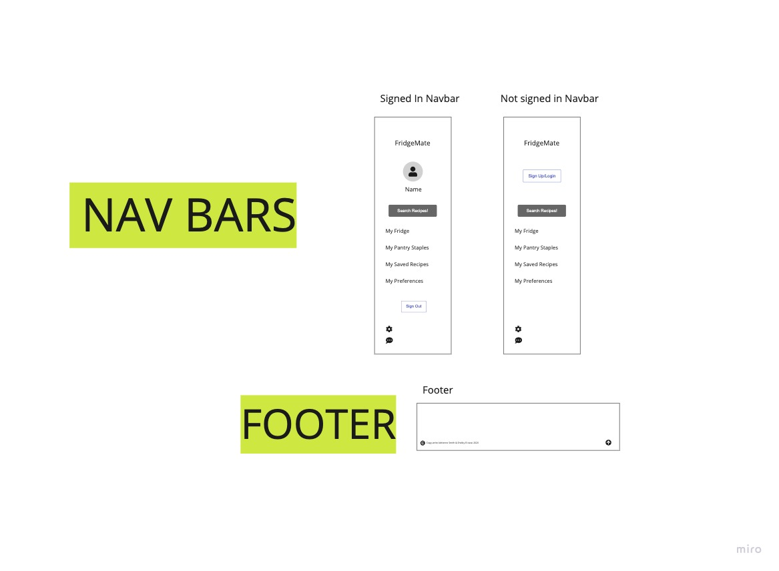
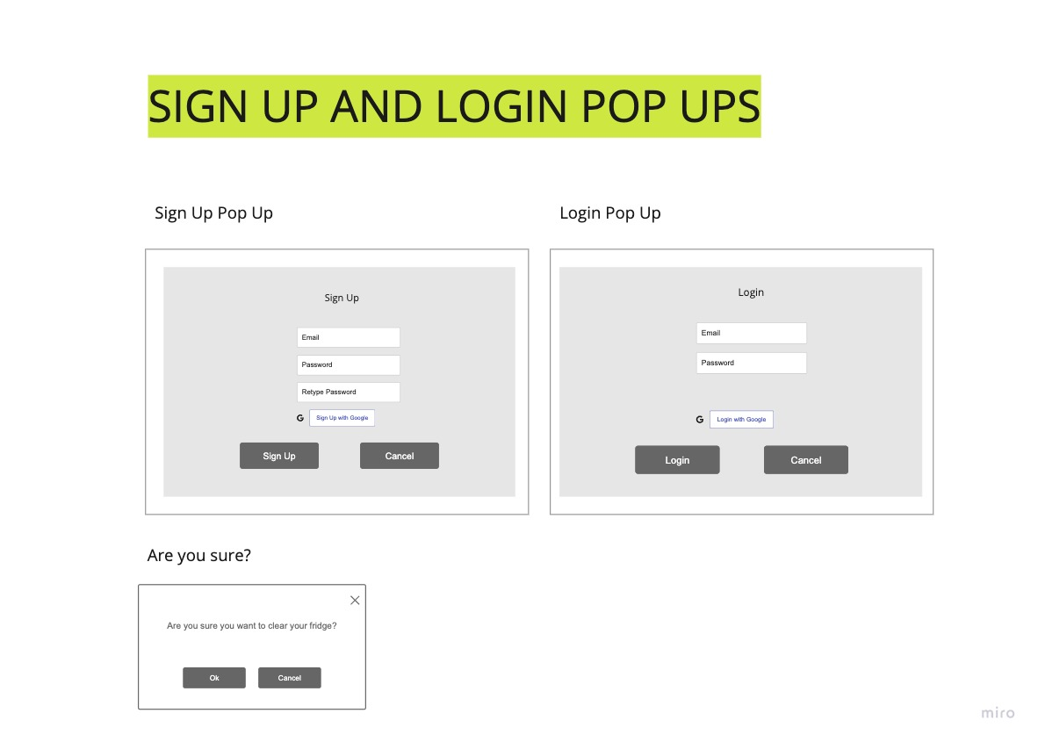
What:
Notes:
Skim over – we have all the wireframes

Slide 6
What:
Notes:
Skim over – we have all the wireframes

Slide 7
Notes:
Hooray they come to life with prototypes!

Slide 8
Notes:
Skim over – point is we have all the wireframes

Slide 9
Who:
Key Demographics
Gender, family status, profession, language,
main interests.
Key Psychographics
Likes and dislikes.
Challenges
What app will help them with.
Preferred channels
Celeb chefs, social media, etc.
Preferred content types
Blogs, social media posts, etc.
Notes:
Just read the headings, “we thought about people’s…”

Slide 10
MVP Features:
Authentication.
User accounts.
User preferences.
Fridge/pantry ingredients.
Recipe search.
Save recipes.

Slide 11
Extra Features:
Search history.
Oauth.
Recipe of the week.
Collections.
Meal time filter.
Rate and review.
Profiles.

Slide 12
User Stories:
General user stories.
Stories for user profiles.
Stories for beyond MVP.

Slide 13
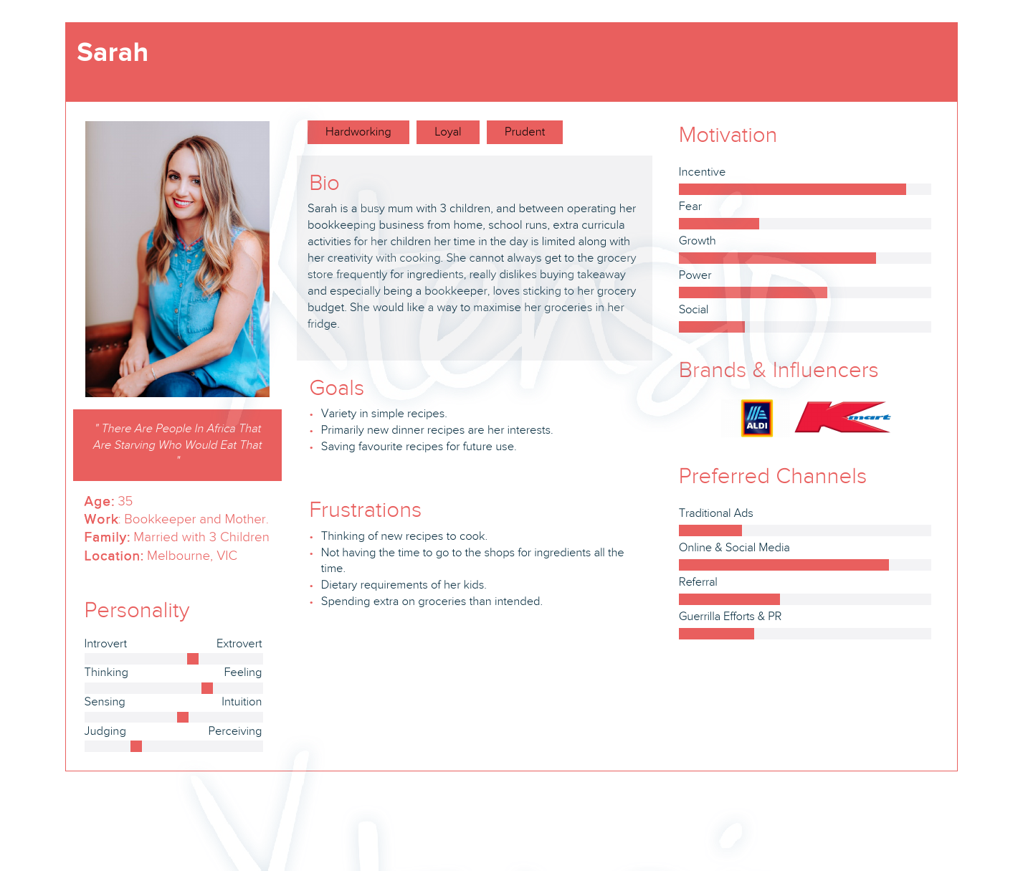
Who:
Notes:
We have 4 user personas.

Slide 14
How:
Design and Planning:
Trello
Miro
Xtensio
Framer
Lucid Chart
Slack
Frontend:
HTML5
CSS3
React JS
JavaScript
JSX
Material-UI
Bootstrap
Axios
Backend:
ExpressJS
Node JS
Passport
Passport-JWT
Express Session
Database:
MongoDB
Mongoose
Testing:
Cypress
Supertest
Mocha
Other:
Edamam API or Spoonacular
Heroku
Netlify
Notes:
Tech stack

Slide 15
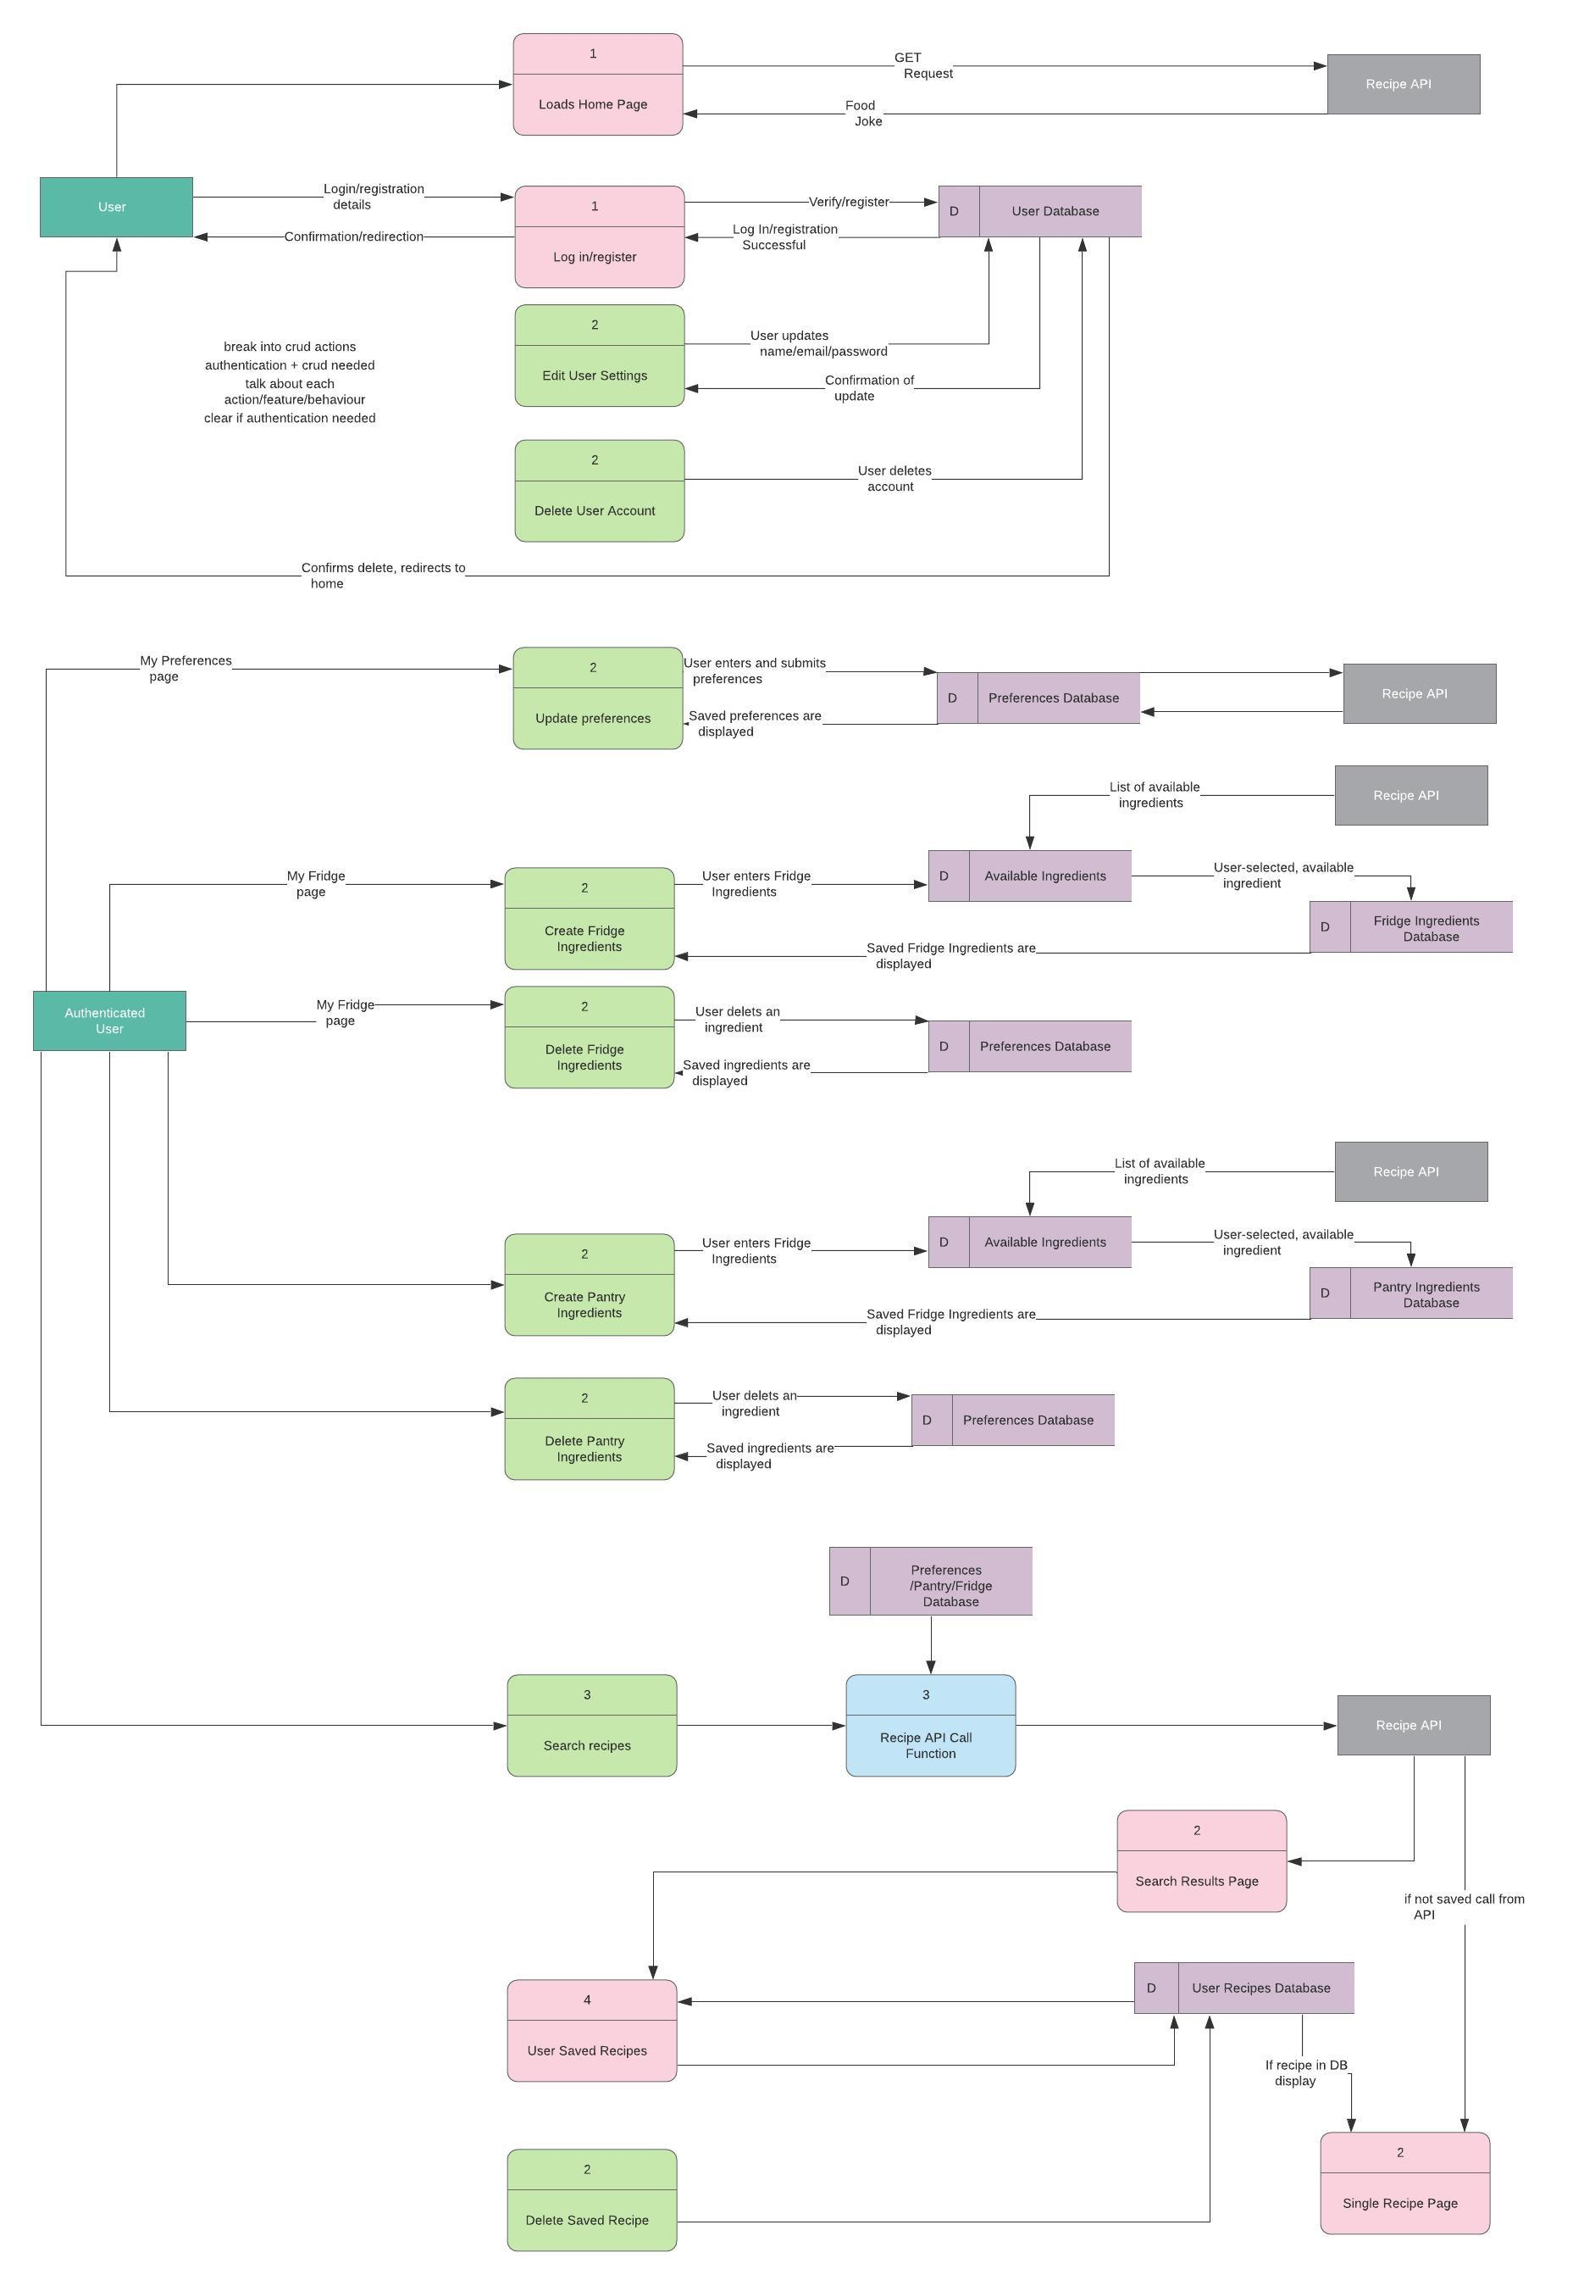
How:
https://github.com/CA-MERN/MERN-Part-A-Docs/blob/main/diagrams/DFD.jpeg
Notes:
Skim over – basically user needs to be logged in, user info and ingredients/preferences saved in DB, recipes come from API searching with DB info. They can click on the link if they want to see more.

Slide 16
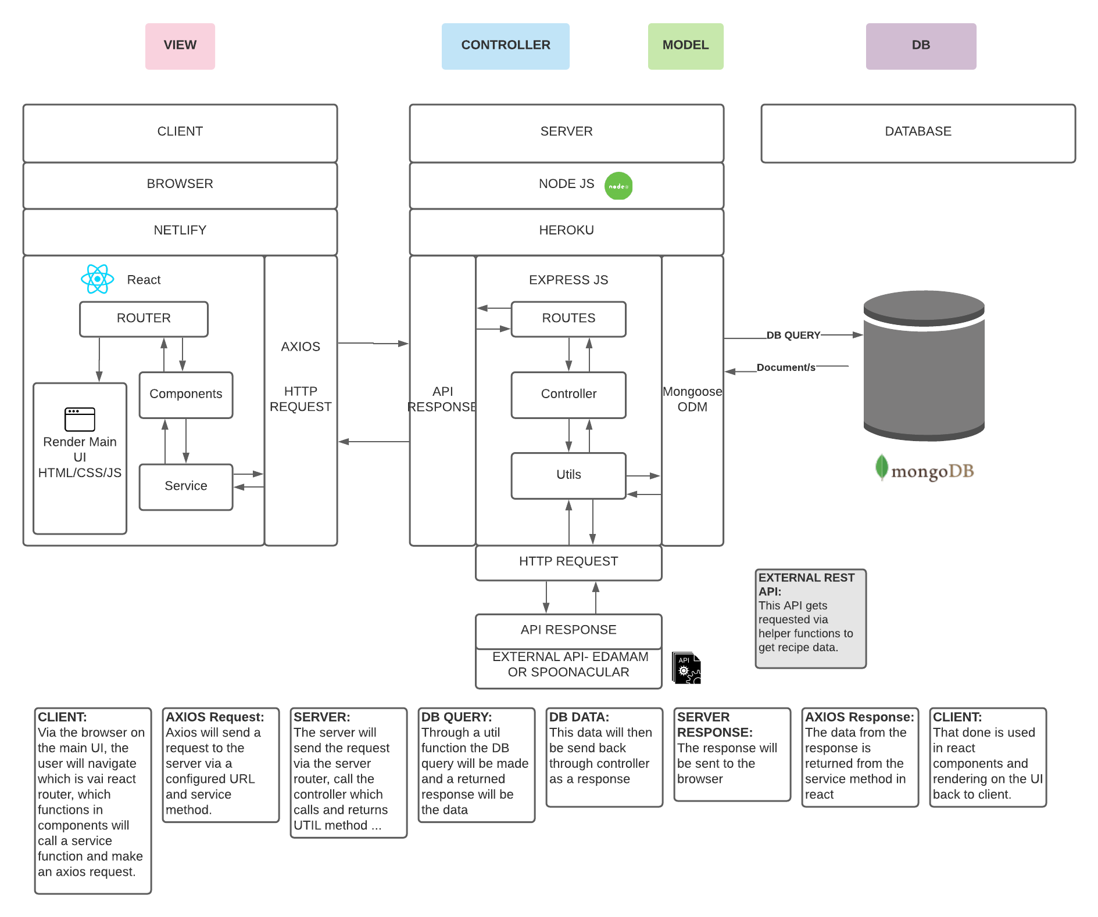
How:
https://github.com/CA-MERN/MERN-Part-A-Docs/blob/main/diagrams/aad.png

Slide 17
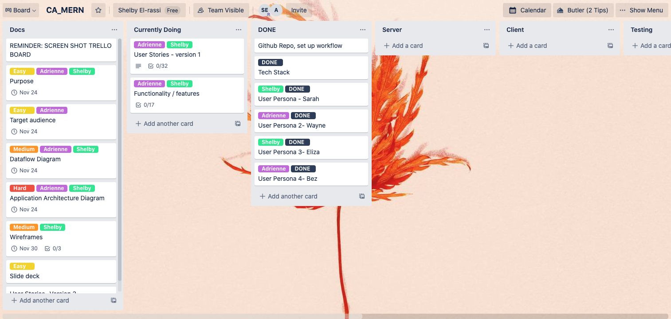
When:
Notes:
Using trello, doing sprints kind of?

